Slide 1
FastTrack for Dynamics 365
Dual-Write
Implementation Workshop
Created On: 18/03/2021

Slide 2
Dual-Write Workshop Agenda
Agenda
Understand your DW Design, provide best practices review, highlight any risks and gaps in the plan. Product roadmap and release alignment.
Application Strategy
Business Process Strategy
Attendees: Key stakeholders from the customer and partner teams. Solution architects, functional and technical leads are mandatory.
Requirements: Solution Blueprint WS completed. High level Solution Architecture completed. Project plan and team roles defined.
Integration Strategy
Environment & Capacity Strategy
Data Strategy
Test Strategy
Security Strategy
Gaps & Risks

Slide 3
Introductions

Slide 4
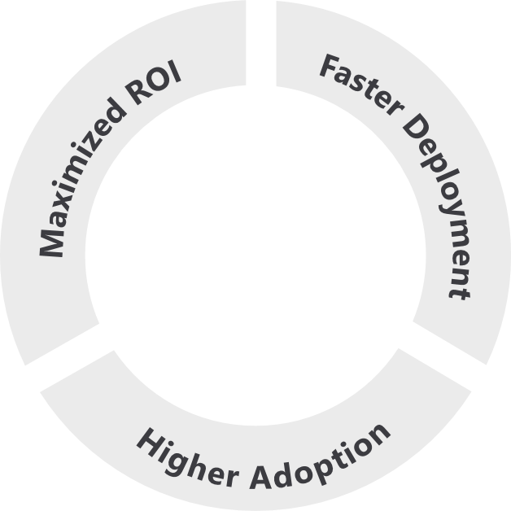
Based on Success by Design
The Dynamics 365 engineering team brings you the learnings and experiences from 3000+ cloud deployments through Success by Design.
Success by Design (SbD) is the prescriptive guidance - approaches & recommended practices - for designing, building and deploying a Dynamics 365 solution.
It is grounded in fundamentals of good solution architecture and design, product capabilities, and proven approaches to business process transformation and implementation.
Designed around three core principles:
2.2x
higher usage of Dynamics 365
Early Detection
Proactive Guidance
Predictable Success
Notes:
Source: The data point of 2.2x higher usage of Dynamics 365 is based on data analysis by the FastTrack team on the MAU of FastTrack tenants vs non-FastTrack tenants for above 500 seats.

Slide 5
The Role of FastTrack
In Scope
Review the answers provided
Provide findings and recommendations following the workshop presentation
Provide alternatives to product gaps identified
Highlight technical and project risks and issues (including unrealistic product expectations)
Point out gaps in the solution or project structure that can result in an unsuccessful implementation
Out of Scope
Create a solution architecture based on findings
Decide on solutions that best fit gaps identified
Code review
Provide training on product features (user or administrative)
Create comparison between ISV solutions

Slide 6
Instructions for Customer and Partner
How to fill this PowerPoint document
Complete each slide providing the required information
Skip slides that are not applicable to your project
Extend topic area slides to capture the required information if needed. Do not hesitate to paste your own slides.
Reach out to your FastTrack SA if you have questions on the format or content
Send completed deck back to the FastTrack SA 5 business day before the scheduled Solution Blueprint workshop.

Slide 7
Application Strategy

Slide 8
App Strategy - Solution Scope
Main Functional Areas
Sales
Customer Service
Field Service
Project Operations
Marketing
Finance
Commerce
HR
…
Phase & Timeline
Project start: August 2016
Current Project Phase: Design
Target go-live: January 2017
Number of users: 185
Business
Industry: Manufacturing
Business Model: B2B vs B2C
Geos: US and Canada
Default Language: EN-US
Default Currency: USD
Data center: US East
185
Total User Count
2
Geos
3
Project Phases
6
Integrations internal/external
1/4
Total Tenants/ Environments
1
ISV solutions

Slide 9
App Strategy
* Provide information of what Dynamics 365 Apps will be part of your implementation
Apps (* = live) | CDS/F&O Integration | OOB Map or custom map | Estimated Go-live | Using trial?
Sales | DI/DW/Logic Apps | OOB P2C | dd/MM/yyyy | Yes/No
Customer Service (CS)
Project Service Automation
Field Service | DW | Custom
Marketing
Customer Insights
Product Insights
Finance
Fraud Protection
Human Resources
Supply Chain Management
Commerce
* Delete what not applicable

Slide 10
Business Process Strategy

Slide 11
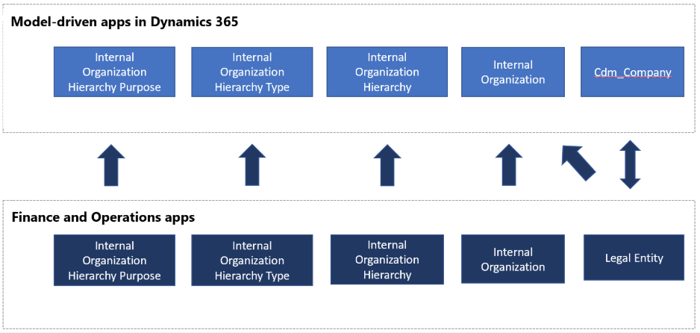
Business Process Strategy
Example – Please update as appropriate
Dynamics 365 Apps: Sales / Customer Service / PSA / Field Service / Marketing / Finance
Process: <Process Name>
A blueprint that provides a conceptual view of the data integration data flows being implemented.
Example: The sales process, Field Service process, or custom regulatory process, etc.
💡 Check the Appendix section for App related examples

Slide 12
Integration Strategy

Slide 13
Integration Strategy
Example – Please update as appropriate
How is number sequencing handled for each app?
Will filtering source data be required?
Y/N
What are the integration triggers?
Examples:
Will there be rules that trigger integration other than standard Create, Update or Delete operations?
Will there be a requirement to have high volumes of data integrated through Dual-Write?
Y/N
Are there business processes that will trigger a bulk creation or update to integrated records in different apps?
Y/N

Slide 14
Integration Strategy
Example – Please update as appropriate
How many legal entities are part of Dual-write integration?
#
Is cross-company data sharing being used in F&O apps?
Y/N
Will data sharing across legal entities be used? If yes, will this data be integrated?
Y/N
Is there a requirement to sync files across different apps? If so, what is the approach to integrate files?

Slide 15
Environment & Capacity Strategy

Slide 16
Environment Strategy
Example – Please update as appropriate
Please describe your environment strategy
Provide CE and F&O environment details and how they’re connected, including environments that are part of the Application Lifecycle Management strategy (Dev, Test, UAT, etc.)
For production environments, are there multi-environments in a single tenant, single environment, or multi-environments in multi-tenants (across CE and F&O).
Ex.: Environment URL in CE <-> Environment URL in F&O (purpose, legal entities, etc.)

Slide 17
Environment Strategy
Example – Please update as appropriate
Are you planning to use trial environments during the implementation for dual-write?
In Dataverse/CE: Y/N In F&O: Y/N
Will apps be installed in the same tenant?
Y/N
Will apps be deployed in the same region?
Y/N
Are there any data sovereignty requirements
Y/N
Is there an alignment of your release process across different apps?
Y/N
Is there a monitoring process for Dual Write integration status and errors?
Add approach for monitoring

Slide 18
Data Strategy

Slide 19
Data Strategy
Example – Please update as appropriate
What will be the approach to migrate data (Third-party tools, Initial Sync, etc.)?
Provide data migration strategy across CE and F&O. Including tools, volumes and timelines.

Slide 20
Data Strategy
Example – Please update as appropriate
Planning to use Initial Sync feature?
Y/N
Is there a responsibility matrix for data migration activities?
Y/N
Will historical data be migrated and synched?
Y/N
Will there be additional data migration activities post initial go-live?
Y/N
What is the cut-over approach for data migration?
Add approach/strategy

Slide 21
Test Strategy

Slide 22
Test Strategy
Example – Please update as appropriate
Does your test plan include testing DW synchronization across both platforms?
Y/N
Does the test plan focus on performance for business processes (e.g., Prospect to cash)?
Y/N
Does the test plan include testing planned and unplanned outages/maintenance of each app?
Y/N
Have you identified performance metrics for DW integration, especially for key scenarios?
Y/N
Are those metrics reviewed after each iteration and included in the design?
Y/N
Have you confirmed if the Service levels are according with your needs/expectations? E.g., time that takes for a record to synchronize across both platforms
Y/N

Slide 23
Security Strategy

Slide 24
Security Strategy
Example – Please update as appropriate
Have you tested the access to data across different apps?
Y/N
Does your test plan focus on the security aspect as well?
Y/N
Is the security model aligned across the several applications?
Y/N
What is the plan to align the security model and make it scalable for future changes (e.g., new legal entities, etc.)
Add approach/strategy
Examples:
Alignment between F&O legal entities and CE Business Units
Record ownership and the impact to record level security

Slide 25
Gaps & Risks

Slide 26
Gaps & Risks
Example – Please update as appropriate
Product gaps Identified
Risks identified based on upcoming changes
* Provide detailed information on this topics if applicable to your Program.
Detail all identified gaps and risks as well as questions that may exist.

Slide 27

Disclaimer
© 2021 Microsoft Corporation. All rights reserved. Microsoft, Microsoft Dynamics, Office 365, Windows, and other product names are or may be registered trademarks and/or trademarks in the U.S. and/or other countries. The information herein is for informational purposes only and represents the current view of Microsoft Corporation as of the date of this presentation. Because Microsoft must respond to changing market conditions, it should not be interpreted to be a commitment on the part of Microsoft, and Microsoft cannot guarantee the accuracy of any information provided after the date of this presentation. MICROSOFT MAKES NO WARRANTIES, EXPRESS, IMPLIED OR STATUTORY, AS TO THE INFORMATION IN THIS PRESENTATION

